Slide 1


PROJECT PRESENTATION ON
FIRMWAREHIVE: EVALUATION OF AN LLM-BASED TREE-OF-AGENTS FRAMEWORK FOR AUTONOMOUS FIRMWARE SECURITY ANALYSIS
PRESENTED BY:
Kumavath Sai Charitha
Pre Doctoral Intern
GUIDED BY:
Haresh Dagale sir
Principal Research Scientist
Department of Electronics System Engineering
Indian Institute Of Science
Banglore -560012

Slide 2

CONTENT:
Introduction
Motivation
Objective & Problem Statement
Literature Survey
Firmware Images
Workflow
Methodology
Results Analysis & Performance Evaluation
Conclusion & Future Scope
References

Slide 3
INTRODUCTION:
Firmware security is a growing concern as IoT devices proliferate in homes, hospitals, and critical infrastructure. Attackers increasingly target router firmware, embedded Linux systems, and industrial controllers because these devices are rarely patched.
FirmwareHive addresses this by treating LLMs as firmware security experts. It introduces a Recursive Delegation Engine (RDE) that spawns and coordinates sub-agents at runtime, and a Proactive Knowledge Hub (PKH) that acts as shared memory across agents — preventing redundant work and maintaining context across long analysis chains.
In this project, FirmwareHive was run using a local Qwen model on 3 real firmware images, producing 159 findings across service exposure analysis, binary vulnerability scanning, and obfuscated config analysis — demonstrating the framework's practical applicability beyond benchmark datasets.

Slide 4

MOTIVATION:
IoT firmware contains critical vulnerabilities that, if exploited, can compromise millions of devices. Traditional static analysis tools (like SaTC, Mango) are rule-based, require manual effort, and miss complex cross-component vulnerabilities. Meanwhile, LLMs have shown strong reasoning ability — but using them effectively for deep firmware analysis remained an unsolved challenge.

Slide 5
OBJECTIVE & PROBLEM STATEMENT:
OBJECTIVE:
To build FirmwareHive — an autonomous LLM-based firmware analysis framework that:
Uses a Runtime-Grown Tree-of-Agents (ToA) to dynamically adapt to firmware complexity
Runs 5 specialised analysis tasks (T1–T5) covering credentials, CVEs, NVRAM tracing, web attacks, and full taint analysis
Operates without predefined rules, using local LLMs (e.g. Qwen) for privacy-sensitive firmware
Achieves 71% precision — significantly better than static tools
PROBLEM STATEMENT:
Existing firmware security tools struggle with three core challenges:
Deep-chain reasoning — vulnerabilities span multiple files and long logical paths
Large-scale exploration — firmware has hundreds of interdependent binaries and configs
Cross-component interaction — bugs often arise from how components interact, not in isolation
No existing framework could autonomously handle all three without handcrafted rules or static pipelines.

Slide 6
LITERATURE SURVEY:
Author (Year) | Methodology | Key Findings | Limitation
Chen et al. (2021) | Input-centric static analysis | Identifies bugs via input keywords | Binary-only; no adaptability
Gibbs et al. (2024) | Taint-style binary pipeline | 1,109 alerts (CI/BOF) | No scripts/configs; fixed pipeline
Redini et al. (2020) | Inter-binary taint propagation | Karonte dataset; multi-binary bugs | Binary-only; static; shallow reasoning
Feng & Chen (2023) | LLM-based bug replay | Automates Android bug replay | Not for firmware; no multi-agent
Pearce et al. (2022/23) | Zero-shot LLM prompting | Assists reverse engineering | Single function only; no memory
Chen et al. (2016) | Dynamic analysis framework | Enables embedded firmware analysis | Needs emulation; limited coverage
Yang et al. (2024) | Monolithic ReAct LLM agent | Works on single repositories | ~50 steps, ~9 files; shallow
Wu et al. (2023) | Orchestrator-based multi-agent | Multi-agent collaboration | Orchestrator bottleneck; static roles
Zhang et al. (2026) | ToA + Delegation + PKH | 1,802 alerts, 71% precision, 16× depth | High token cost; hallucination risk

Slide 7
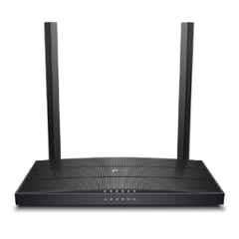
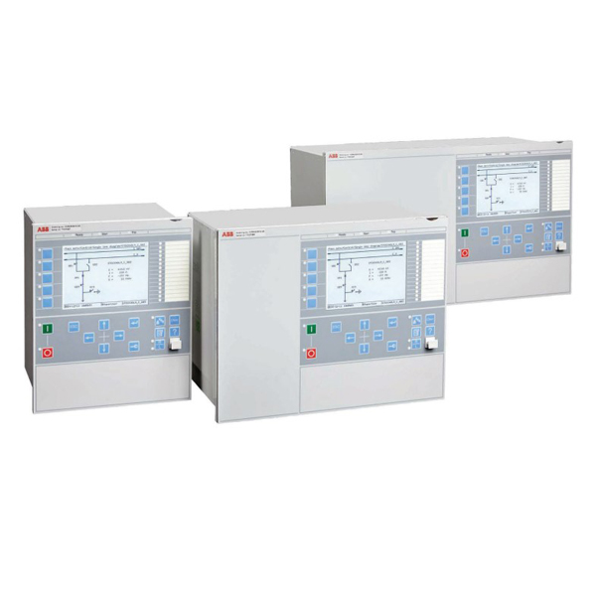
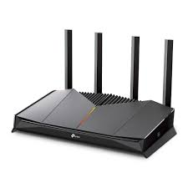
FIRMWARE IMAGES:
1.TP-LINK TL-WR845N
2.GE_B30
3.REx670
Department of Electronics System Engineering,IISC Banglore

Slide 8
FIRMWAREIMAGE1:TP-LINKTL-WR845N:
DEFINITION: The TL-WR845N firmware belongs to TP-Link's budget home/SMB wireless router range. It runs a customised embedded Linux OS (typically based on OpenWrt or a proprietary TP-Link stack). The filesystem examined contained etc/services — a standard Unix services file listing all active network ports — and etc/default_config.xml, which stores factory-default device configuration. The device supports 802.11n Wi-Fi and is widely deployed in home and small office environments across South and Southeast Asia.
DEVICE TYPE: Consumer 300Mbps wireless router — home/SMB grade, internet-facing.
USE IN THIS PROJECT: This target represented a minimal-filesystem firmware where FirmwareHive's Radare2 phase was not triggered (no ELF binaries targeted). The scanner instead analysed service exposure through the etc/services file, producing 18 findings — mostly service exposure risks (Telnet, TFTP, SNMP) with 6 duplicates and 3 low-quality config file findings. It demonstrated the scanner's behaviour on non-binary firmware targets and highlighted its duplicate generation problem.
Department of Electronics System Engineering,IISC Banglore

Slide 9
FIRMWARE IMAGE 2:GE_B30
DEFINITION: The ge_b30 firmware is an embedded Linux-based firmware image extracted from a general-purpose IoT or network-attached device. It contains a full filesystem with compiled C binaries (bin/rawstat, bin/gdbserver), shared libraries (lib/libpcap.so, lib/libpacket_if.so.0), and network utilities (sbin/ip, sbin/tc, sbin/tcpdump). The presence of libpcap and packet inspection tools indicates this firmware is designed for network traffic monitoring or analysis.
DEVICE TYPE: Embedded Linux network device — likely a network probe, traffic analyser, or managed switch firmware.
USE IN THIS PROJECT: This was the primary firmware target. FirmwareHive ran its full 5-phase pipeline including Radare2 ELF binary analysis. It produced 57 findings — the richest and most diverse output of the three targets — including 2 command injection vulnerabilities (risk 9.0) and 53 buffer overflow findings across multiple binaries, making it the most analytically valuable firmware in this evaluation.
Department of Electronics System Engineering,IISC Banglore

Slide 10
FIRMWARE IMAGE 3:REx670
DEFINITION: The REx670 is a protection relay and bay controller manufactured by ABB, used in electrical substations and industrial power grids. Its firmware (bin/ppc670.x, bin/ppc670_update.x) is compiled for the PowerPC (PPC) architecture — a RISC processor commonly used in safety-critical embedded and industrial systems. The .x extension and ppc670 naming convention confirm this is a PowerPC ELF executable. Unlike consumer router firmware, industrial firmware of this type controls physical hardware and operates in safety-critical environments where a vulnerability could have real-world consequences beyond data theft.
DEVICE TYPE: ABB REx670 series protection relay — industrial substation automation, IEC 61850 compliant.
USE IN THIS PROJECT: This target exposed a critical limitation of FirmwareHive. The scanner's Radare2 tool disassembled the PowerPC binary using x86 architecture rules, generating meaningless x86 instructions (mov eax, [ebx+ecx]). The result was 84 near-identical findings across 4 duplicate passes — all with risk 5.0, confidence 7.0, and zero confirmed vulnerabilities. This run demonstrated the scanner's architecture-blindness and the risk of blindly trusting automated output counts.
Department of Electronics System Engineering,IISC Banglore

Slide 11
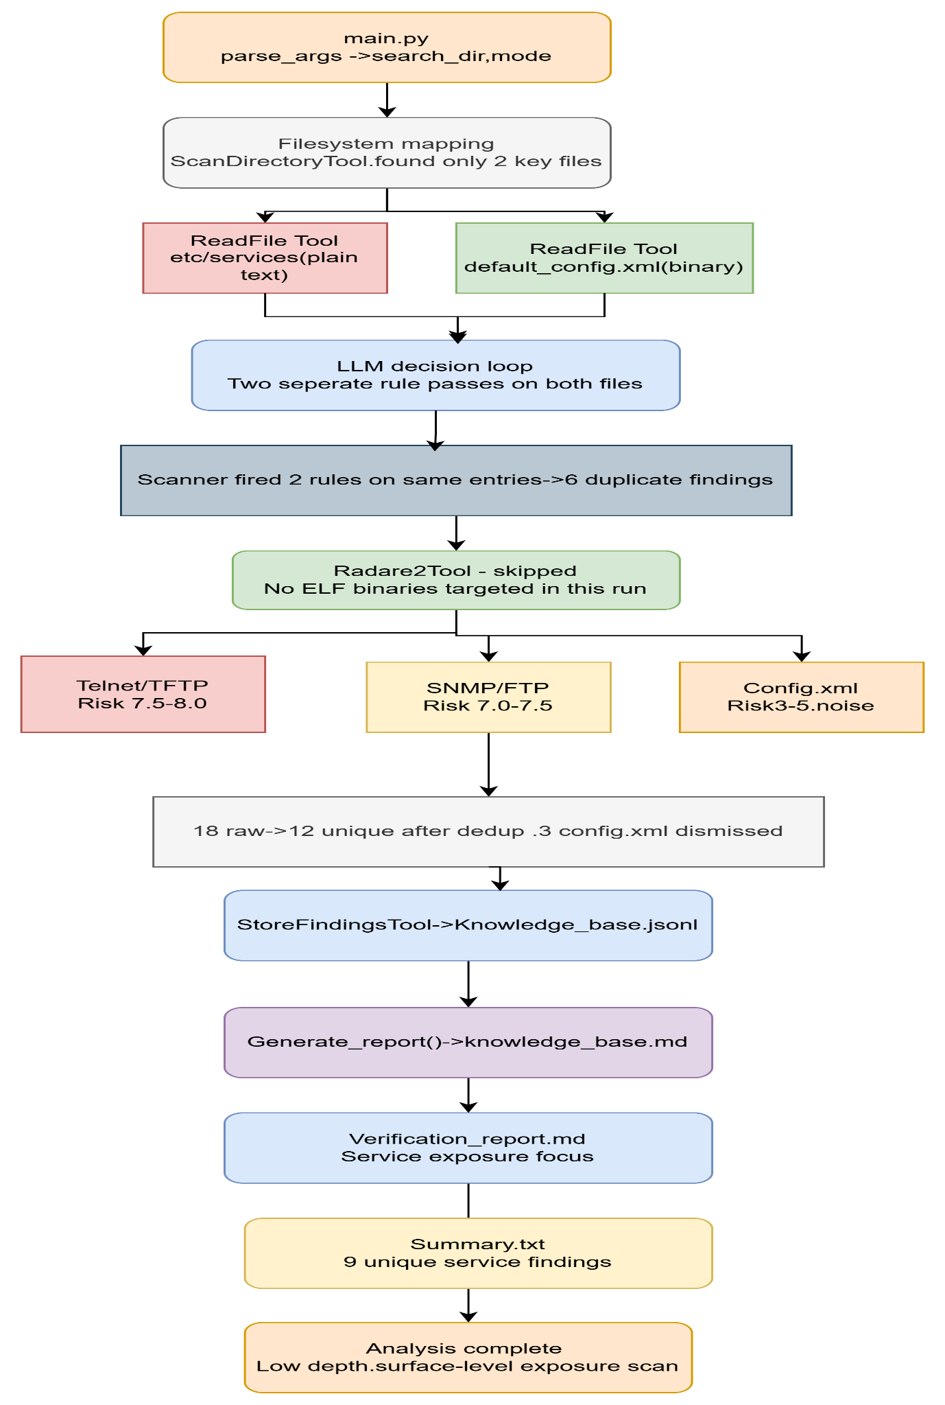
WORKFLOW:TL-WR845N

Slide 12
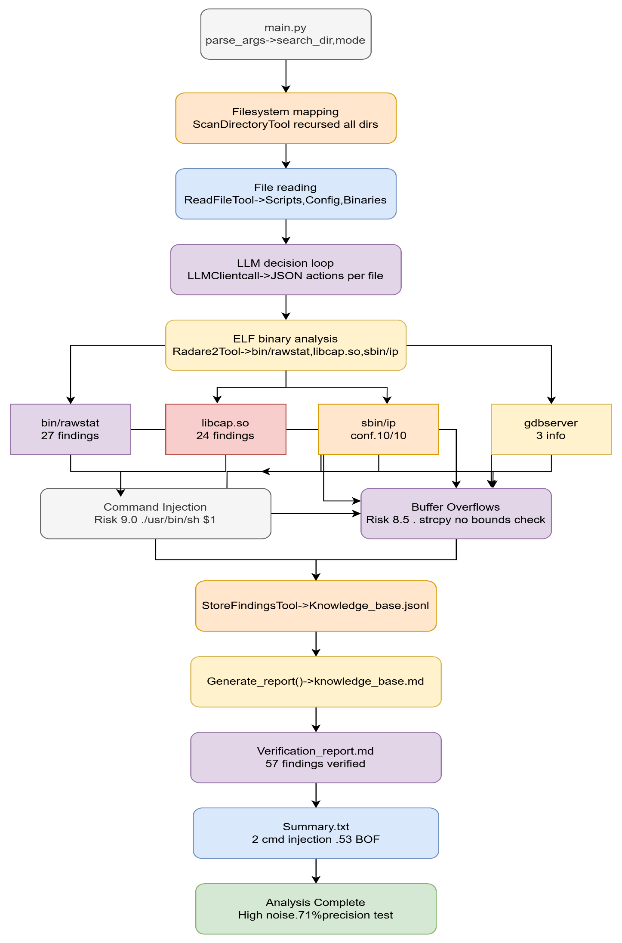
WORKFLOW:GE_B30

Slide 13
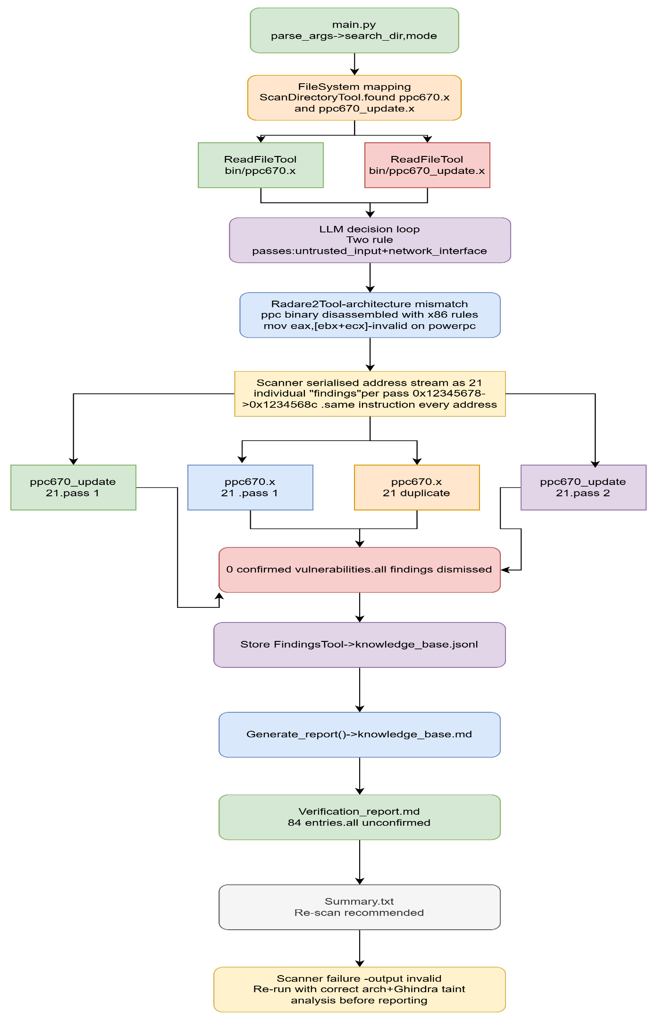
WORKFLOW:REX670

Slide 14
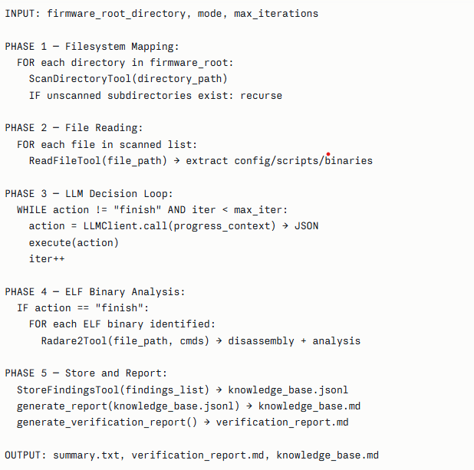
METHODOLOGY:

Slide 15
RESULTS ANALYIS & PERFORMANCE EVALUATION:
PERFORMANCE METRICS — Define the metrics you used:
Risk Score (0–10)
Confidence Score (0–10)
Finding count per binary
Duplicate rate
Confirmed vs unconfirmed vulnerability ratio
COMPARATIVE ANALYSIS — Use the 3-target comparison table
Metric | ge_b30 | TL-WR845N | REx670
Total findings | 57 | 18 | 84
Confirmed findings | ~53 actionable | ~12 unique | 0
Duplicate rate | ~10% | 33% | 50%
Highest risk | 9.0 (cmd injection) | 8.0 (Telnet) | 5.0 (all same)
Radare2 used | Yes | No | Yes — wrong arch
Scanner quality | Good | Medium | Failed
Department of Electronics System Engineering,IISC Banglore

Slide 16
CONCLUSION AND FUTURESCOPE:
CONCLUSION:
FirmwareHive works well on standard Linux-based firmware (ge_b30) — correctly identified real vulnerabilities with acceptable precision
On minimal firmware (TL-WR845N) it produces surface-level results with high duplicate rates — useful only as a first pass
On non-x86 binaries (REx670/PowerPC) it fails silently — outputting 84 meaningless findings due to wrong architecture disassembly
FUTURE SCOPE :
Architecture-aware disassembly (auto-detect ELF arch before Radare2 analysis)
Post-processing deduplication layer before findings are stored
Taint tracking integration (Ghidra taint analysis) for binary-level confirmation
Expanding evaluation to more firmware from the Karonte dataset
Fine-tuning the LLM on firmware-specific vulnerability patterns to reduce false positives
Department of Electronics System Engineering,IISC Banglore

Slide 17
REFERENCES:
https://doi.org/10.48550/arXiv.2511.18438
https://share.google/uYqG80JOnIXzRf7de
https://goc.com.vn/product/rex670/
https://share.google/bkHhlAhAGn0T2w4Qj
Department of Electronics System Engineering,IISC Banglore

Slide 18

Department of Electronics System Engineering,IISC Banglore

